Slide 1
Women in Pharma ®

Slide 2
Women in Pharma® (WIP)
ABOUT
Mission Statement:
ISPE Women in Pharma® (WIP) provides women in the pharmaceutical industry a forum for connecting and collaborating on technical and career advancement topics. A community of Women in Pharma® mentors, resources across all levels, and educational sessions will be an enabler for career success and work-life balance.

Slide 3
Women in Pharma® (WIP)
ABOUT
The ISPE WIP held their inaugural event at the 2016 ISPE Annual Meeting & Expo in Atlanta, Georgia, with 9 panelists from the FDA and industry and approximately 70 attendees. It has since grown remarkably, with well over 120 attendees at the 2017 Women in Pharma Breakfast during the ISPE/FDA/PQRI Quality Manufacturing Conference held in June in Arlington, Virginia.

Slide 4
Women in Pharma® (WIP)
BUTTON PROGRAM
Members of the group will be selling ISPE Women in Pharma® buttons at many of the ISPE International Events.
Those who donate $10 or more ($5 or more for students) will receive a Women in Pharma® button.
Every dollar from the button sales will be contributed to a scholarship fund supporting future opportunities for women in the industry.
Many ISPE Affiliates and Chapters are also participating in the fundraising button program.

Slide 5
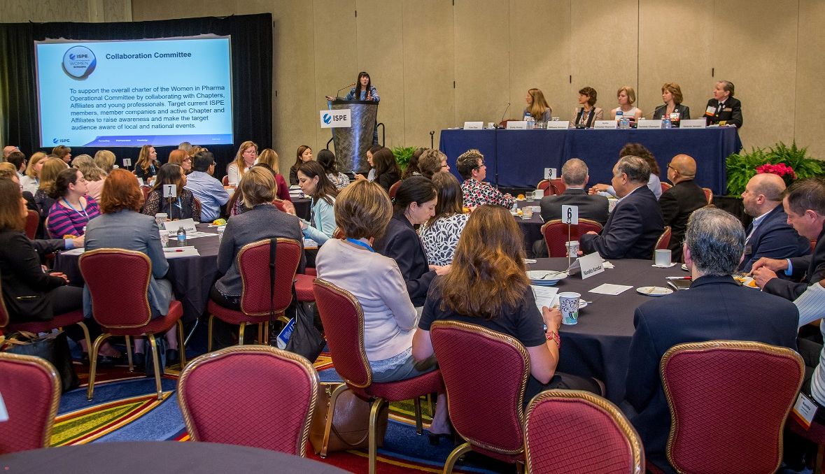
Women in Pharma® (WIP)
ORGANISATION
The WIP group within ISPE is led by a Steering Committee with the following sub-committees:
Marketing
Collaboration
Education and Contribution
If you would like to volunteer for the ISPE WIP groups,
please contact Georgia Keresty at georgia.keresty@earthlink.net

Slide 6
Women in Pharma® (WIP)
Events
Connect with Women in Pharma® Members at ISPE Events:
Breakfast Panel Discussion Sessions
Education Sessions focused on Professional Development
WIP Networking Dinners
Informal Meetups
Local Affiliate and Chapter Events
Affiliates and Chapters who are interested contact the WIP Committee representative: Jim Breen at jbreen4@its.jnj.com. The group has numerous resources to help develop programming and can assist in securing speakers.
Learn more and Join the ISPE Women in Pharma® Online Community at
https://www.ispe.org/women-pharma

