Slide 1
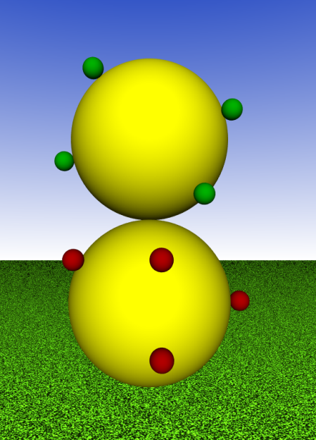
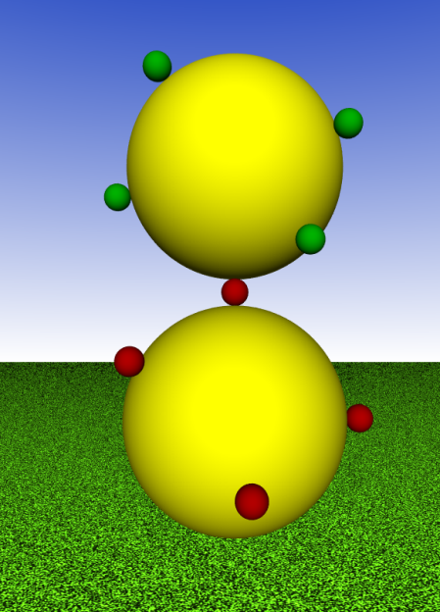
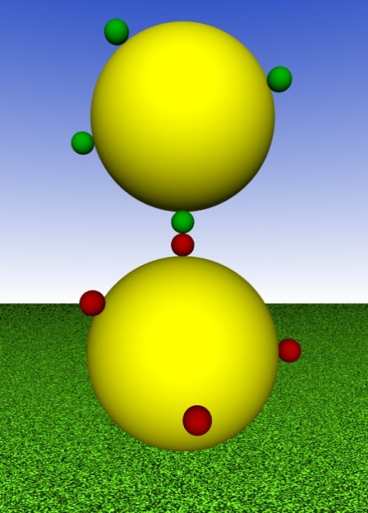
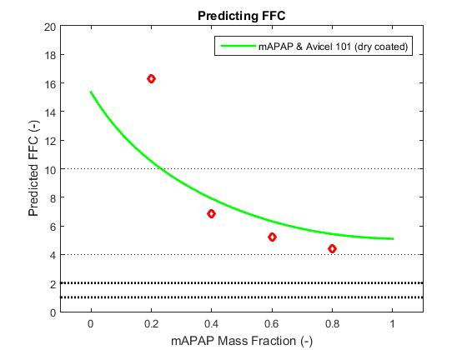
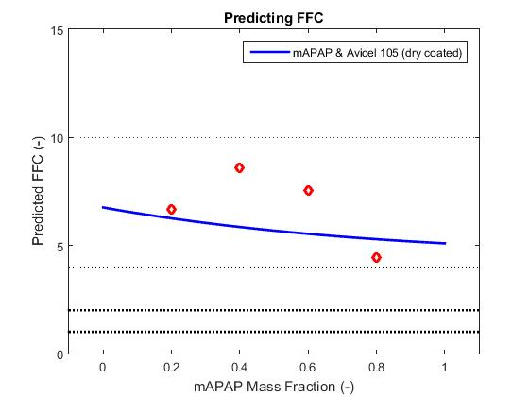
Enabling direct compaction at high drug loading via dry coating of APIs: Towards a predictive framework
Presenter(s): Kuriakose T. Kunnath, NJIT Research Participants: Zhonghui Huang, Rajesh N. Davè
Host
Guest
Results (con’t)
Improvement of bulk properties of pharmaceutical powders made with dry coated cohesive active pharmaceutical ingredients (APIs).
Investigate the ability of dry coating to improve the maximum API loading into pharmaceutical blends
Investigate the effect of dry coating on API content uniformity (CU) in pharmaceutical blends
Investigate the suitability of using various size excipients in pharmaceutical blends
Assess the feasibility of producing adequate tablets from pharmaceutical blends made with dry coated cohesive APIs
Demonstrate the ability of dry coating technology to be utilized in continuous manufacturing (CM) processes
+
Mechanical
Forces
Host-Host
Host-Guest
Guest-Guest
High speed direct compression (DC) tableting is widely considered as the most ideal process to produce tablets in the pharmaceutical industry
This continuous process is the natural link between continuous API and drug product manufacturing
Requires lower energy, resources, time and money because it does not include laborious granulation or drying operations
Cohesive nature of certain APIs, especially those that are micronized, make implementation of high speed DC impractical
Improvement of bulk properties of cohesive APIs as well as pharmaceutical blends via dry coating technology could enable CM of drug products.
Research Relation to ERC
 | Test Bed 1: Tablet Manufacturing | Test Bed 2: Strip Film | Test Bed 3: Multi-layer products
Thrust A: Materials Formation & Characterization | 
Thrust B: Design, Scale up, & Optimization of Manufacturing Processes
Thrust C: Structural Characterization & Modeling of Products | 
Thrust D: Integrated Systems Science
Material | Function | $$D_{10}$$ $$(µm)$$ | $$D_{50}$$ $$(µm)$$ | $$D_{90}$$ $$(µm)$$
mAPAP | API (Host) | 2.3 | 11.1 | 40.8
Silica R972P | Glidant (Guest) | - | 0.02 | -
Avicel 102 | Coarse Excipient | 32.0 | 122.4 | 244.4
Pharmactose DCL11 | Coarse Excipient | 42.3 | 107.5 | 194.4
Avicel 105 | Fine Excipient | 7.2 | 19.7 | 43.5
Pharmatose 450M | Fine Excipient | 3.6 | 20.2 | 51.5
Magnesium Stearate | Lubricant | 1.4 | 5.45 | 13.1
Impact on Testbed(s)
By improving bulk properties of pharmaceutical blends, critical quality attributes (CQAs) are also improved. This indicates at the feasibility of CM of pharmaceutical blends with cohesive APIs.
Conclusions
Dry coating of cohesive APIs facilitate the production of pharmaceutical blends with high API loading capabilities as well as adequate flow and compaction properties. Content uniformity and flowability of fine, cohesive APIs can be improved via dry coating, and then mixing with fine excipients.
Future Work
Further develop model to correlate particle properties of manufactured APIs to (1) maximum allowable API loading in pharmaceutical blends, (2) the degree of necessary surface area coverage via dry coating and (3) the ideal excipients to pair with said API in order to manufacture drug products via high speed DC tableting.
Methods
V – Blender
Volumetric Screw feeder
Comil
Pharmaceutical Blend
V – Blender
Dry Coated API

