Slide 1
How Membership Benefits You

Slide 2
What is ISPE?
ISPE, the International Society for Pharmaceutical Engineering, is the world's largest not-for-profit association serving its Members by leading scientific, technical, and regulatory advancement throughout the entire pharmaceutical lifecycle.
ISPE is committed to the advancement of the educational and technical efficiency of its members through forums for the exchange of ideas and practical experience.

Slide 3
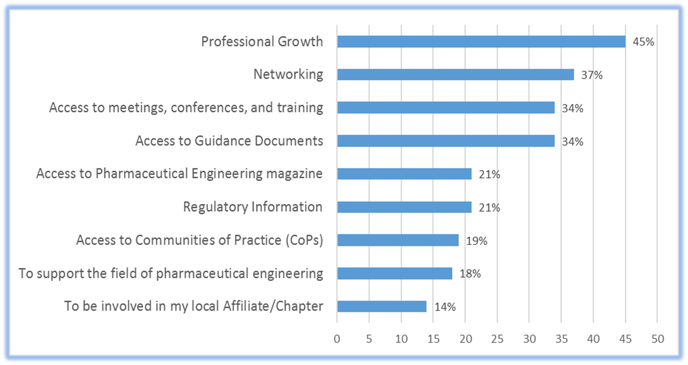
Top Reasons our Members Join

Slide 4
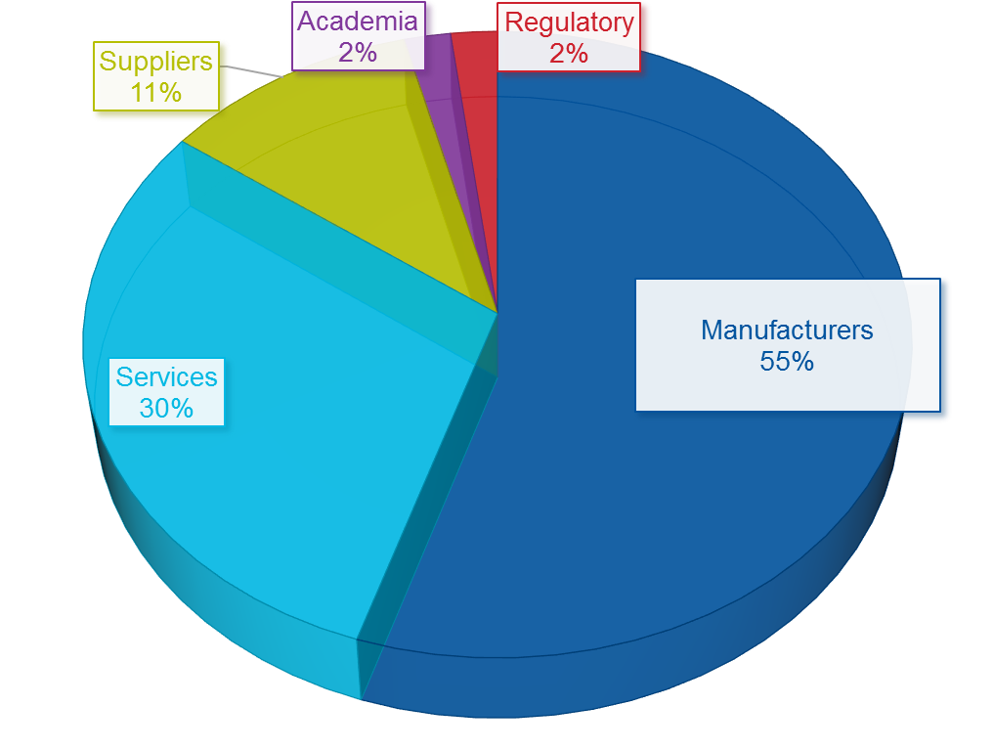
ISPE is Your Professional Home
Members represent all facets of the industry, including:
Contract Manufacturing Organizations (CMO)
Academia
Architecture and Construction
Biotechnology
Generics
Suppliers and Service Providers
Global Regulators
And more…

Slide 7
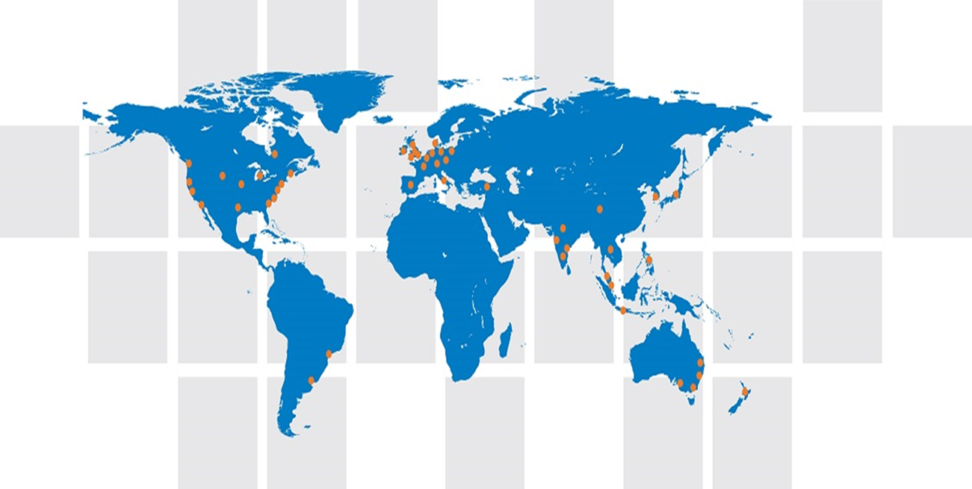
Local Networking on a Global Scale
Local Affiliate (International) or Chapter (US) membership is included when you join ISPE. Get involved at the local level to make life-long industry contacts and friends. Attend events to network with Members from around the world.

Slide 8
More Networking Opportunities
Find other like-minded professionals through the Membership Directory
Join an online Community of Practice (CoP) to ask questions, discuss ideas, and get involved in product development
Attend Training and Conferences at either the global level or local level through Affiliates/Chapters

Slide 9
Technical resources

Slide 10
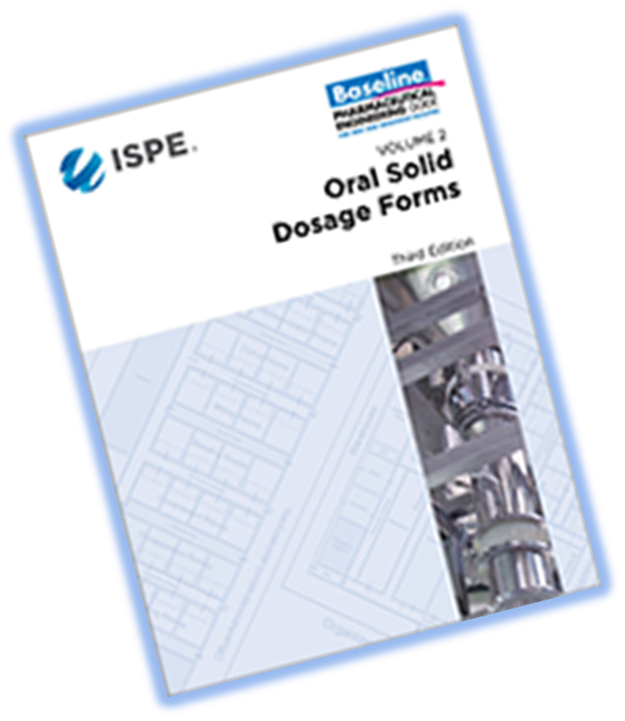
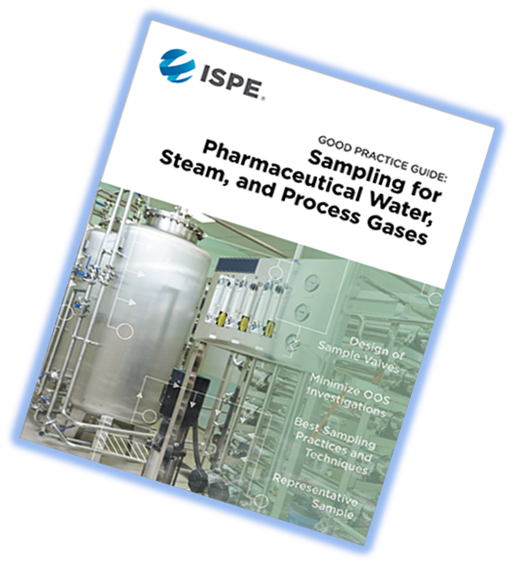
ISPE Guidance Documents
ISPE Guidance Documents are the “gold standard” in the industry.
Choose from:
Baseline® Guides
GAMP® 5 and GAMP® Good Practice Guides
Good Practice Guides
Product Quality Lifecycle Implementation® (PQLI®) Guides and Good Practice Guides (GPGs)

Slide 11
Pharmaceutical Engineering Magazine
Pharmaceutical Engineering is ISPE’s bi-monthly technical magazine published for Members engaged in all aspects of research, development, and manufacture of safe and effective medicines and medical devices.
Every issue, members can read about:
facilities and equipment
information systems
product development
production systems
quality systems
research and development
supply chain management
regulatory compliance

Slide 12
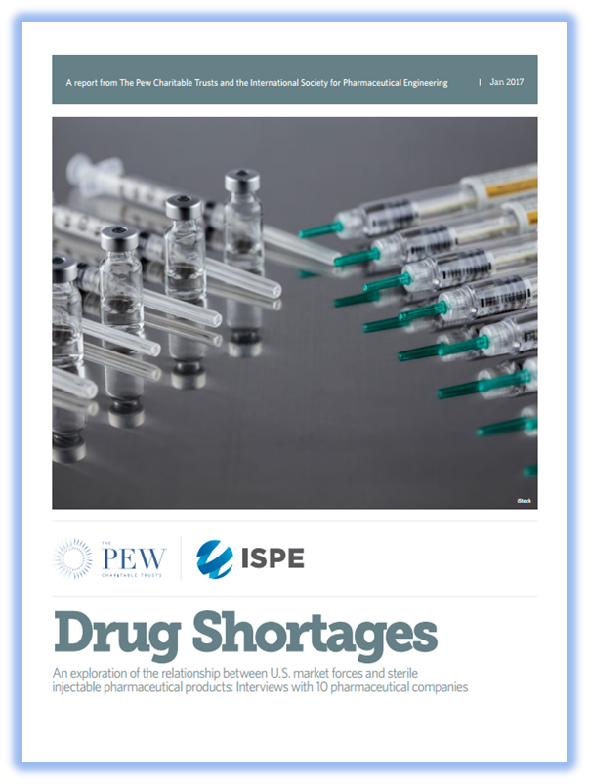
Regulatory Initiatives
ISPE members have the opportunity to review and comment on Guidance Documents.
ISPE also works with member volunteers on:
Drug Shortages
Quality Metrics
Blended Uniformity / Content Uniformity
Regulatory and Compliance Committee (RCC)
Product Quality Lifecycle Implementation® (PQLI)

Slide 14
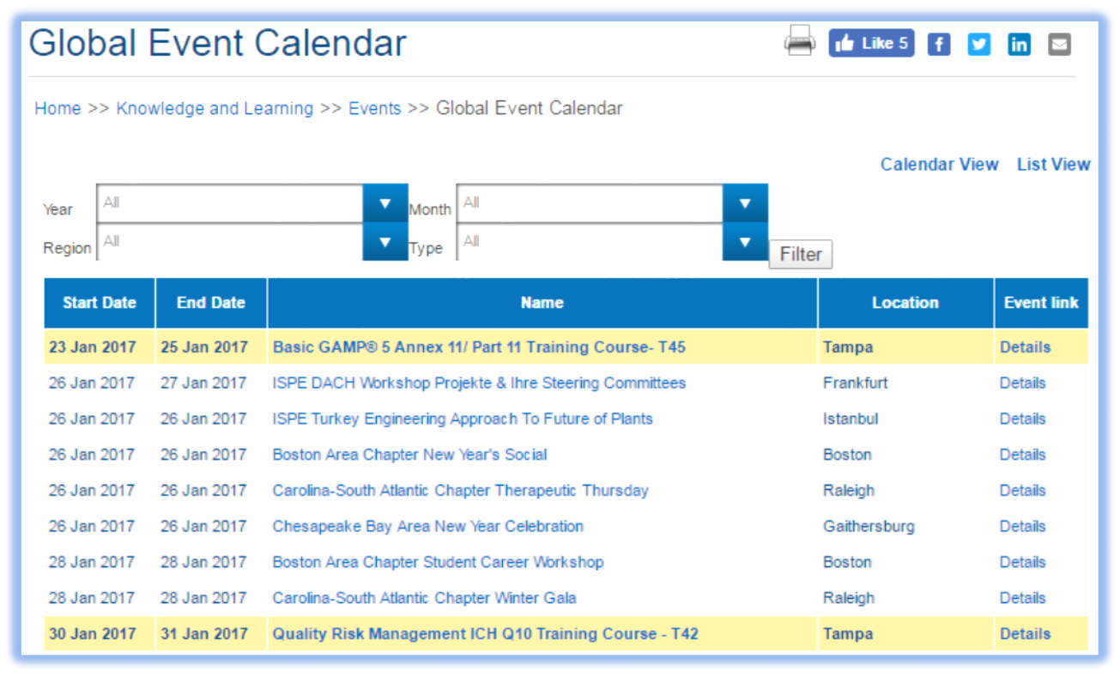
Education Around the World
There are continuing education opportunities almost every day of the year somewhere in the world! Through ISPE Global or your local Affiliate/Chapter, there are hundreds of programs to keep you growing in your career.

Slide 15
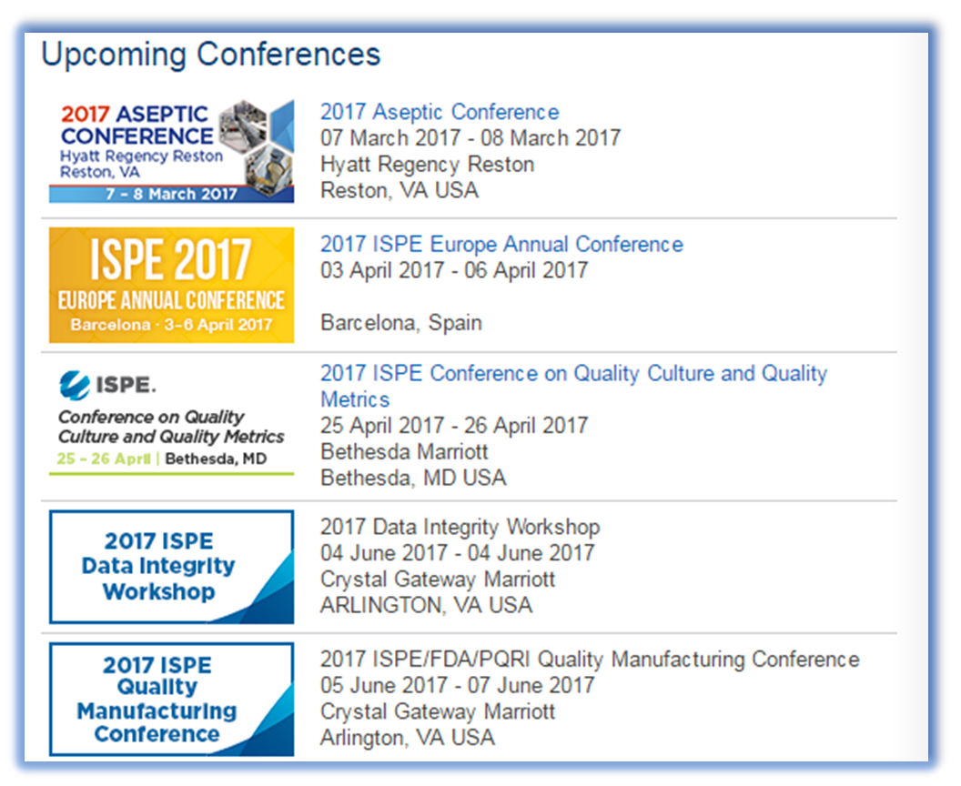
In-Depth and In-Person
Network and problem-solve with top pharmaceutical and biopharmaceutical industry figures, learn about important industry topics, meet with suppliers, and share best practices with colleagues at ISPE Conferences, such as:
ISPE Annual Conference & Expo
ISPE Europe Annual Conference
Aseptic Conference
ISPE Conference on Quality Culture and Quality Metrics
Data Integrity Workshop
Process Validation Conference
ISPE/FDA/PQRI Quality Manufacturing Conference
And more…

Slide 16
ISPE offers you in-person, focused training at the International Training Institute in Tampa, FL, locally in your region, and at your company if you like. Course topics include:
Biotechnology
Cleaning
Commissioning and Qualification
Facilities
GAMP®
GMPs
HVAC
Manufacturing
Project Management
Quality by Design
Validation
Water

Slide 17
eLearning Expanded Courses offer ISPE's signature training, the type usually delivered over two to three days in a distant classroom, from your home or office
General Industry Knowledge provides general knowledge while giving an industry overview, historical background, and the basic building blocks to get you started
Fundamental Industry Knowledge Courses are ISPE’s pre-recorded courses, developed and reviewed by expert instructors and international regulatory advisors
GMP Courses teach the U.S. Food and Drug Administration’s Systems-based GMP Inspection Approach
Webinars offer self-running courses for a quick tutorial

Slide 18
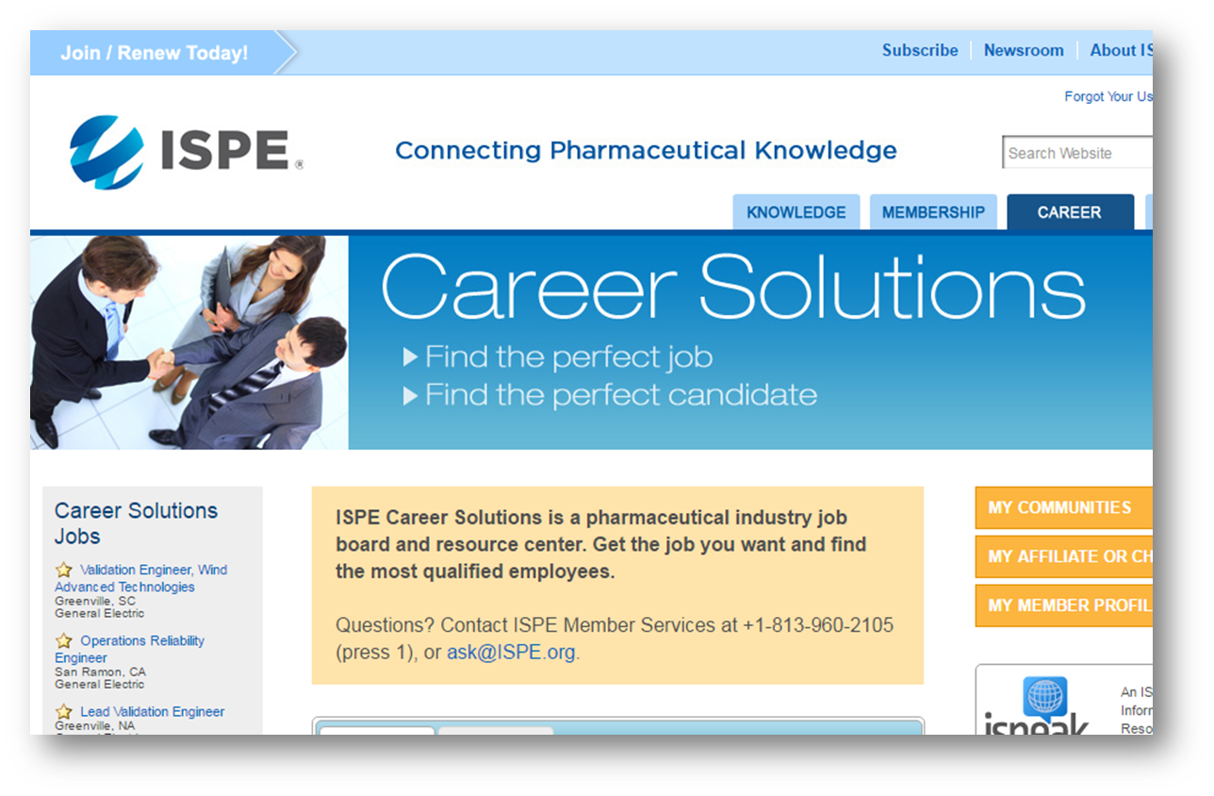
ISPE Career Solutions
Online job bank ─ ISPE Career Solutions
Post your resume
Search jobs
Set up a job alert
Post jobs

Slide 21
Get Involved and Get Inspired
Become a Volunteer to shape the organization, help others grow professionally, and give back to the industry. You can be a:
Speaker
Pharmaceutical Engineering author and reviewer
Technical document author and reviewer
Committee and Task Force volunteer
Communities of Practice (CoPs) participant
Affiliate/Chapter leader
Recruiter for new Members!

Slide 23
Student & YP Member Dues
ISPE significantly discounts dues for Student and YP Members:
Student Members: $25 / €25**
Individuals enrolled full-time at a college, university, or other
Emerging Economy Students: $5 / €5**
Individual students residing in an emerging economy country receive discounted dues. For a list of eligible countries, please visit http://www.ispe.org/index.php/ci_id/43816#emergingeconomy
Young Professionals Members: $119/ €99**
Individuals just starting in the industry, one to four years after graduation

Slide 24
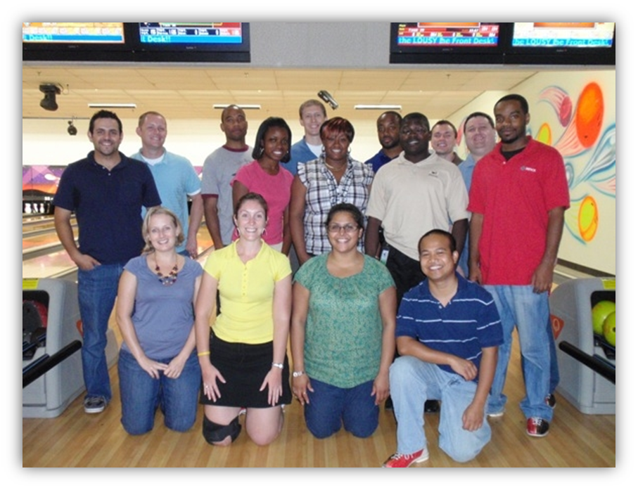
YP & Student Group Activities can include …
Social
Bowling
Happy hours
Educational
Workshops
Training sessions
Guest speakers
Career Development
Mentorship programs
Scholarships and more!

Slide 25
See how ISPE Membership can
benefit you!
www.ISPE.org/Membership

