Slide 1
Argos Therapeutics, Inc.

Slide 2
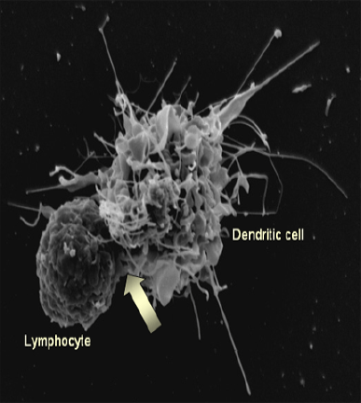
Argos Therapeutics is an immunotherapy company developing new treatments for cancer, infectious and autoimmune diseases, and transplantation rejection.

Slide 3
Argos Quick Facts
Based in Durham, North Carolina (Duke spin-out)
Lead programs utilize personalized dendritic cell-based technology platform (“Arcelis™”)
Licensing deals and NIH contract have resulted in over $110M in non-dilutive cash
3 person mgmt team has combined 22 yrs with Argos
Strong syndicate: TVM Capital, Forbion Capital, Lumira Capital, Intersouth Partners
Notes:
Strength of Arcelis has attracted..

Slide 4
Immunotherapy Company with Oncology Focus
Programs
Preclinical
Phase 1
Phase 2a
Phase 2b
Phase 3
Arcelis Oncology
AGS-003
RCC
Arcelis HIV: AGS-004*
HIV
AGS-009 (Anti-IFN-α mAb)
SLE
sCD83
Transplant/
IBD
* Fully funded by NIH
All programs derived from our dendritic cell biology research

Slide 5
Arcelis™ Core Technology (AGS-003)
Autologous monocyte-derived dendritic cells electroporated with total amplified autologous RCC RNA
Most Powerful Antigen Presenting Platform
Proprietary monocyte-derived dendritic cells (DCs)
Patient-specific
Most Effective Antigen Platform
Amplified total tumor mRNA
Patient-specific
The product is perfectly matched to each patient’s unique tumor

Slide 6
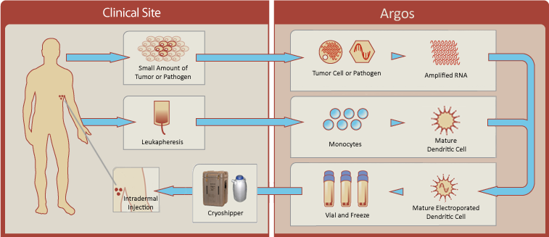
Arcelis Platform Overview
Manual process is robust (>100 patients and 650 doses)

Slide 7
Benefits of Monocyte-Derived DCs
Easily harvested from whole blood
Easily cryopreserved for multiple dosing from a single production run
Excellent clinical safety record based on numerous academic and corporate clinical trials
Optimized for centralized manufacturing
High transfection efficiency with RNA (unlike DNA)

Slide 8
Properties of Amplified RNA
RNA is translation-competent and generates thousands of proteins when translated in vitro
Perfect for delivering broad antigen payloads
Amplification preserves the relative ratio of tumor antigens (out of 22,573 genes tested, 93% differed < 1.5-fold from the original tumor)
Amplified RNA accurately represents the tumor immunome
Compared to peptides, RNA is much more efficient at generating T cell responses in vitro
RNA enhances DC immunopotency via activation of Toll-like receptors

Slide 9
Optimized Arcelis Platform
Immune monitoring data from initial RCC trial provided opportunity to optimize the process
Pre-treatment, all patients were completely immunosuppressed (no IL-2 or IFN-γ responses)
Initial Arcelis process only restored IL-2 response (MB-002)
Developed a superior proprietary process with enhanced immunopotency (AGS-003)
AGS-003 fully restores immune function: both IL-2 and IFN-γ
Optimized process being tested in combination with Sutent
Notes:
Private mutations key to breaking tolerance; proprietary DC process = most potent APCs

Slide 10
Patient by Patient PFS Data for AGS-003 + Sutent Exceeds Expectation for Sutent Alone
A
B
A – Sutent PFS in poor risk subjects (3.7 months)
B – Sutent PFS in intermediate risk subjects (10.6 months)
MSKCC Poor Risk
MSKCC Intermediate Risk
subjects continuing treatment
Time from Registration to Progression
(months)
Notes:
As of Sept 13th 2010

Slide 11
Rationale for HIV Therapeutic Vaccines
Anti-retroviral therapy (ART) does not clear the virus
Non-AIDS events are increasing
Long-term ART may be associated with serious health risks
Survival in ART-treated HIV patients is lower than in the general population
Strict compliance with ART is critical, but does not always occur
Therapeutic vaccines offer hope for delaying decision to start 1st line ART and for 2nd and 3rd line ART patients

Slide 12
AGS-004 Shows Efficacy in Phase 2a trial in HIV Patients
10 clinical centers
AGS-004 dosing every 4 weeks
8 weeks
12 weeks
ART
ATI*
ATI & Booster Phase
12 weeks
If VL< 10 000/ml and CD4> 350
Results in a marked reduction in viral diversity
15 of initial 18 patients responded with avg. viral load reduction of > 88%
6 patients have been without ART for between 4 months and > 1 year with stable CD4 cell counts and low VL

Slide 13
HIV Viral Load Reduction
Mean reduction in viral load for responders (n=14 of 22) = -1.30 log
Notes:
Asked Lee W. for electronic version to incorporate properly.

Slide 14
Overview of Production Capabilities
Centralized GMP manufacturing servicing 25 clinical sites in North America
20,000 sq. ft. GMP facility with separate suites for RCC and HIV
Over 100 subjects dosed and 650 drug doses delivered to date
Automated instruments for cellular and RNA processing
Current manual process shown to be robust
Notes:
CONFIDENTIAL
14
2004 started clinicals in RCC, 35 runs from central manufacturing.
HIV and RCC division cancer and HIV
Current process Charles described quite robust for RCC and good for HIV where we have the most experience.

Slide 15
Manufacturing Challenges
Starting Materials
Processing
Logistics
Commercialization
15

Slide 16
Starting Materials
Biological variability
Tumor – preservative solution, necrotic tissue
HIV plasma samples – viral RNA copies/mL, quasispecies capture
Leukapheresis – sufficient monocytes
Time and temperature sensitivity
Process scheduling
16

Slide 17
Processing
Laboratory methods
Research grade reagents
Manual processing
Open manipulations in biological safety cabinets
Requires highly skilled production associates, significant training
17

Slide 18
Logistics
Materials traceability
Starting material shipments: Timing, temperature
Batch record review
Cryogenic storage of final drug product = shipment of individual doses in liquid nitrogen dewars
18

Slide 19
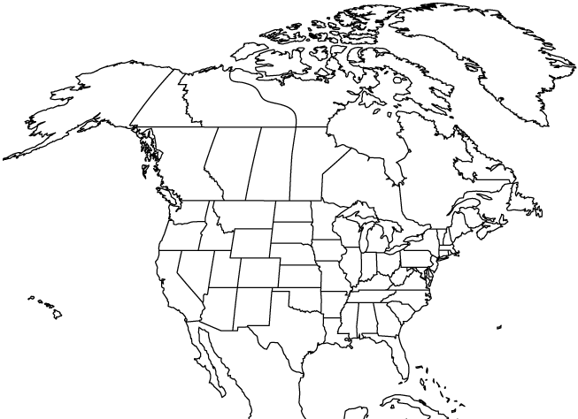
Clinical Sites in HIV and RCC Studies
16 States and 4 Canadian Provinces
HIV Sites:
RCC Sites:
A

Slide 20
Doses Delivered by Year for All Clinical Studies
Cumulative Doses delivered: 650

Slide 21
Clinical Manufacturing Consistency
Parameter | Target | RCC (N=31) | HIV (N=31)
Doses | ≥ 8 | 24 ± 6 | 22 ± 7
Post Thaw Total Viable Cells/Dose | 1.2 x 10⁷ | 1.3 ± 0.2 x 10⁷ | 1.3 ± 0.2 x 10⁷
Post Thaw Viability | ≥ 70% | 82% ± 6% | 83% ± 6%

Slide 22
Clinical Manufacturing Consistency

Slide 23
Commercialization Challenges
Throughput (scale out) instead of scale up
Equipment turnover
Cleaning
Traceability
Batch release
23

Slide 24
Commercial Process Development
Current clinical processing amenable to automation
Performed manually with open manipulations in BSCs
Efficient scale out requires automating process using functionally closed disposables to meet the demands of larger clinical trials and commercialization
Automation project initiated to develop commercial processing methods

Slide 25
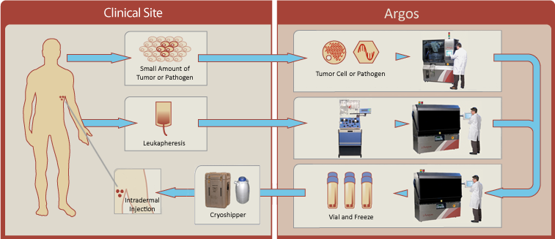
Arcelis™ Automated Processing

Slide 26
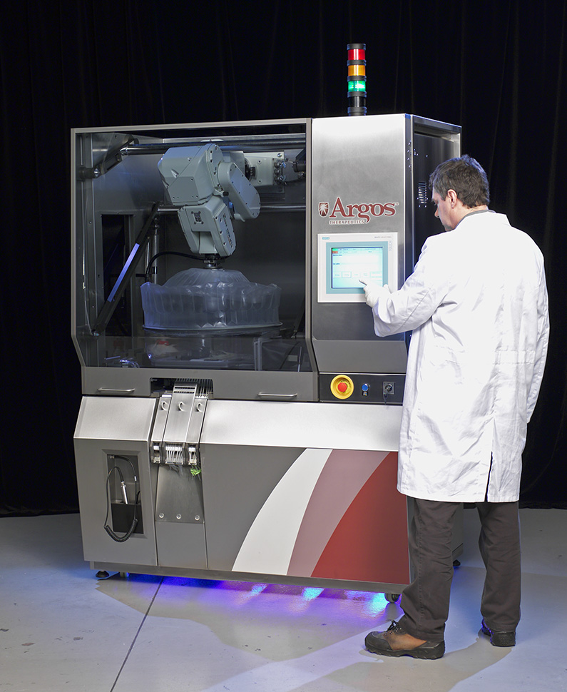
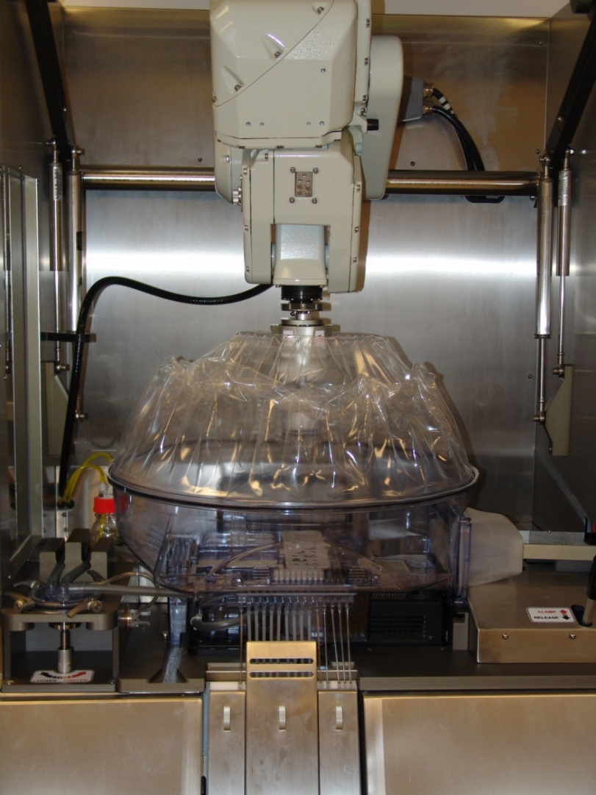
RNA Automated Processing

Slide 27
RNA Functionally Closed Disposable
The equipment interacts with the subject material through the functionally closed disposable. The equipment itself is never in contact with subject material.
Pipette head attached to robot arm
Flexible barrier to allow robot arm movement
Thermal cycler lid inside the thermal cycler boot
Disposable vacuum pump head
Sealed tubing for aliquots

Slide 28
Cellular Automation Results
Parameter | Design Target | Run 1 | Run 2 | Run 3 | Run 4
Doses Filled | ≥ 6 | 10 | 39 | 13 | 26
Cells/Dose (10⁷) | 1.2 ± 0.2 | 1.15 | 1.24 | 1.10 | 1.13
Post-Thaw Viability (%) | ≥ 70 | 79 | 87 | 81 | 76

Slide 29
Cellular Automation Results

Slide 30
First Cellular Therapy Approved
Dendreon’s product Provenge was approved by the FDA for the treatment of prostate cancer in May 2010
First in class approval for an autologous cellular therapy in the US
Demonstrates the potential of autologous cellular therapies in oncology

Slide 31
Arcelis vs. Provenge
 | Arcelis | Provenge
Antigen payload | All tumor antigens Patient specific | Single antigen May not be applicable to all patients
Immunogenicity | Highly optimized DCs 100% are CD54⁺ cells | Poorly characterized Only a fraction are CD54+ cells (FDA potency marker)
Applicability | Any cancer | Prostate cancer
Manufacturing | 1 production run = 20 doses (5 yrs treatment) Long-term stability (can freeze) Automated, closed system Single facility | 1 production run = 1 dose Limited stability (cannot freeze) Manual process Multiple facilities

Slide 32
Automated, Closed System Essential for Successful Commercialization
Allows for competitive pricing in oncology
Ensures consistency and ability to address large markets
Significant reduction in facility and personnel requirements (and expertise)
Addresses virtually all concerns raised by skeptics of Dendreon’s process/ability to commercialize

Slide 33
Argos is Poised for Success
Arcelis personalized immunotherapy is uniquely suited for maximum efficacy and commercialization
Arcelis manufacturing process has been automated allowing for cost-effective production at commercial scale
Clinical data in metastatic renal cell carcinoma (RCC) show clear efficacy signal and support moving into late stage clinical studies

